Slide 1
SCRUM overview
30-11-2016
CONCEPT Unit, PROJECTS Project Management Service

Slide 2
What is Agile and SCRUM
Previous experience of the team
Framework and techniques
Objective: not serve the methodology but have the methodology serve the team
Principle: Self organized team, good collaboration
PMM4EP and SCRUM, will need to combine them
Continuous improvement of the process

Slide 3
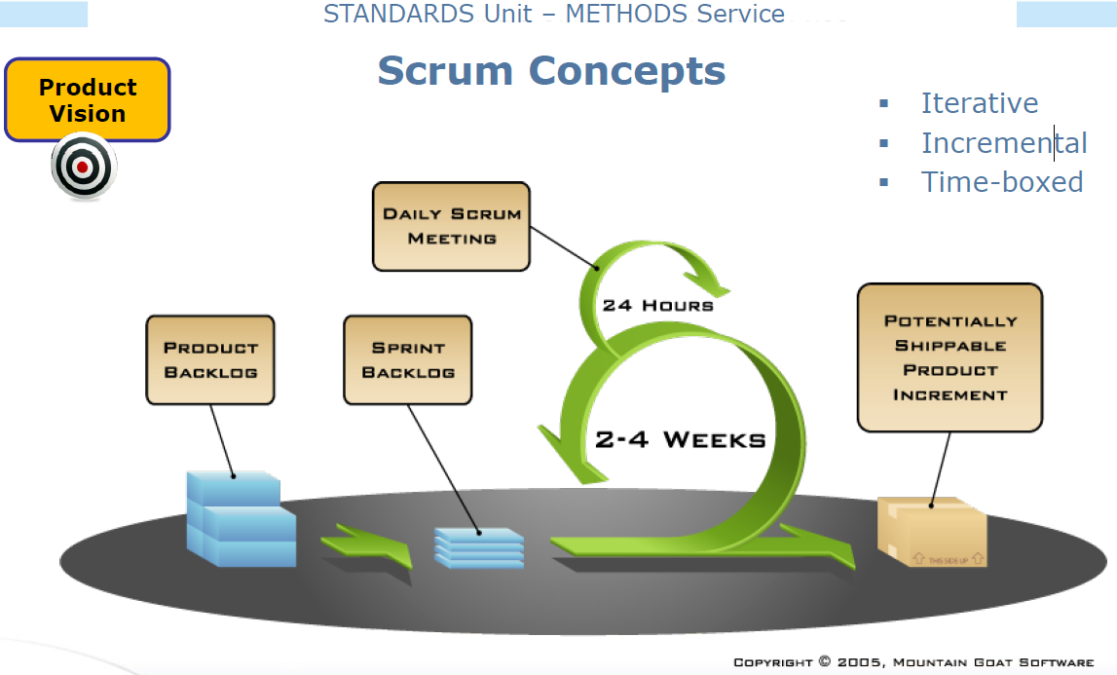

Slide 4
Roles
No PM
Product Owner : Michal
SCRUM Master (slave) : George
gg, George, Michal will have multiple hats
  Particular role in the process and the stand-ups
    Info on strategic decisions
    Remove impediments/facilitate the team’s work/administration support/team organizational tasks
    SPOC for EP external and team external communication
TC –TBD?

Slide 5
Sprint LC/Controls/meetings
Planning meeting, Sprint backlog definition and estimation
Daily process
  Stand-up meetings
  Implementation
Review meeting
Retrospective

Slide 6
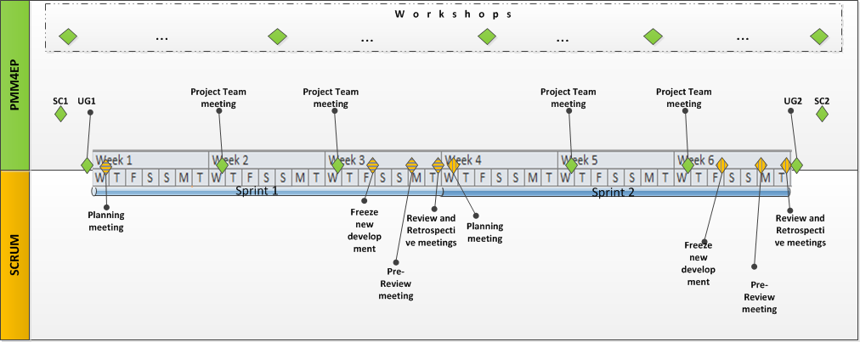

Slide 7
Tools/artefacts
Confluence
  Documentation
  Product backlog
  User stories + validation process
  Sprint backlog and status
  Retrospective starfish
JIRA/Jira scrumboard (KANBAN)
  US -> Jira
  Assignment of US to team member and follow up of status

Slide 8
Stand-up logistics
Daily around mid-day (except short Fridays) – GK to book visio rooms in BXL and LUX
Participants (as today +TC?)
Timeframe: 15mins max (# of persons x 3’)
Content
  What I did since last stand-up
  What I will do until the next stand-ups
  Issues I have – HEEEEEELP!

